Slide 1
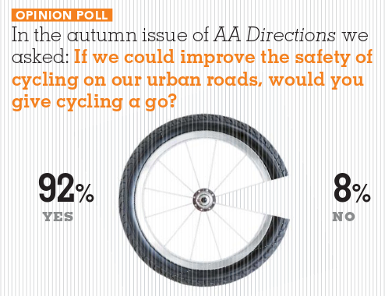
Submission on
Hamilton 2018-2028
10-Year Plan
Cycle Action Waikato
AA Directions magazine, August 2013

Slide 2
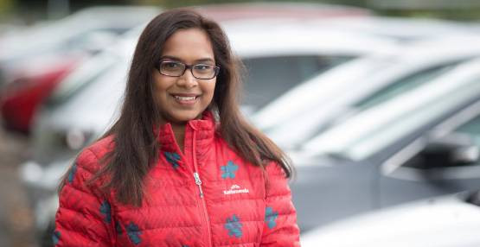
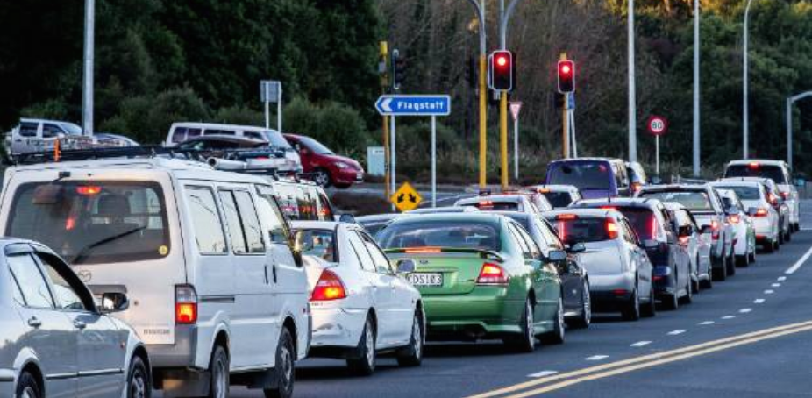
Psychology student Rathee Dewi Siva is doing her PhD on why New Zealanders commute, how they commute and why they use those different modes of commuting.
"In figures released to me by the Ministry of Transport, it showed that there is an 85 per cent driving rate in Hamilton, which is pretty much the highest in the whole country - even more than Auckland."
Stuff.co.nz, April 30 2018

Slide 3
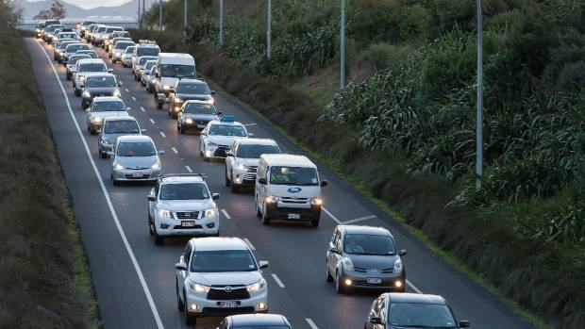
Hamilton motorists told get on the bus or gear up for gridlock
It will take 10 years at least to ease Hamilton's traffic, and even that will require a doubling of people using the bus or bikes.
Stuff, May 1 2018

Slide 4
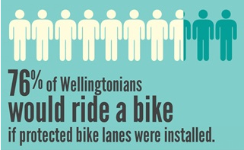
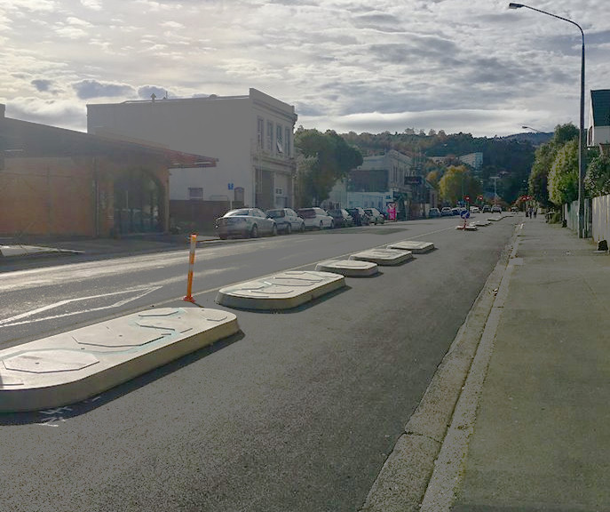
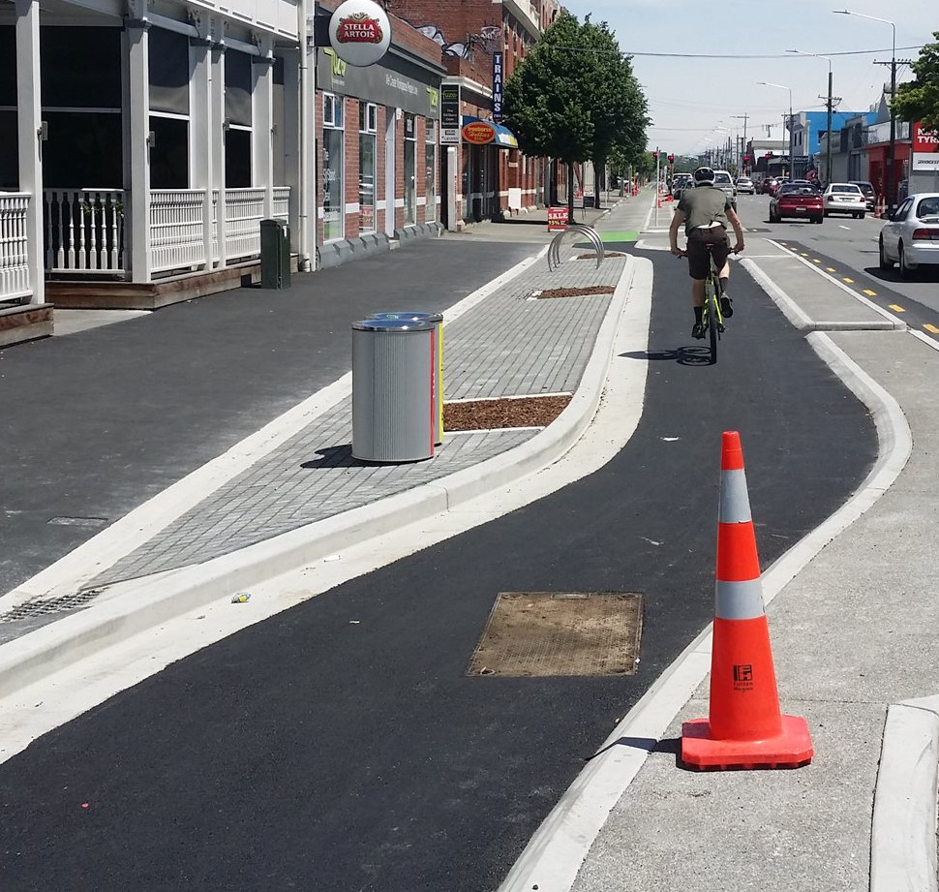
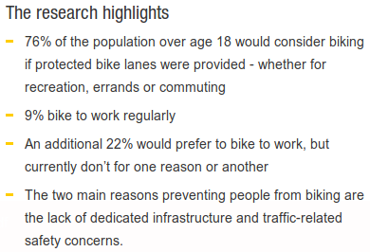
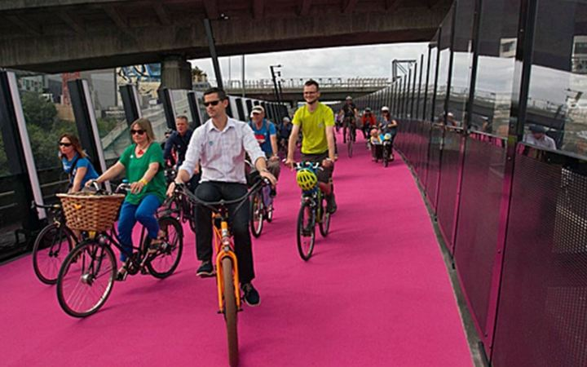
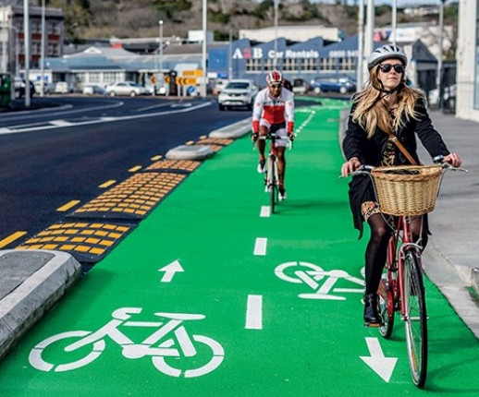
Time to build protected, on-street cycle lanes, as all other major NZ cities are.
Dunedin
Christchurch
Auckland
Auckland

Slide 5
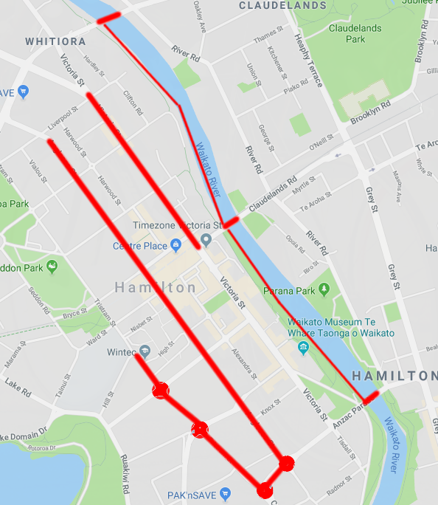
Safe cycling access
to Hamilton CBD?
Issues
River crossings
Scary roundabouts
Major North-South streets
A safe transport network is a necessity, not a “nice to have”.
X
X
X

Slide 6
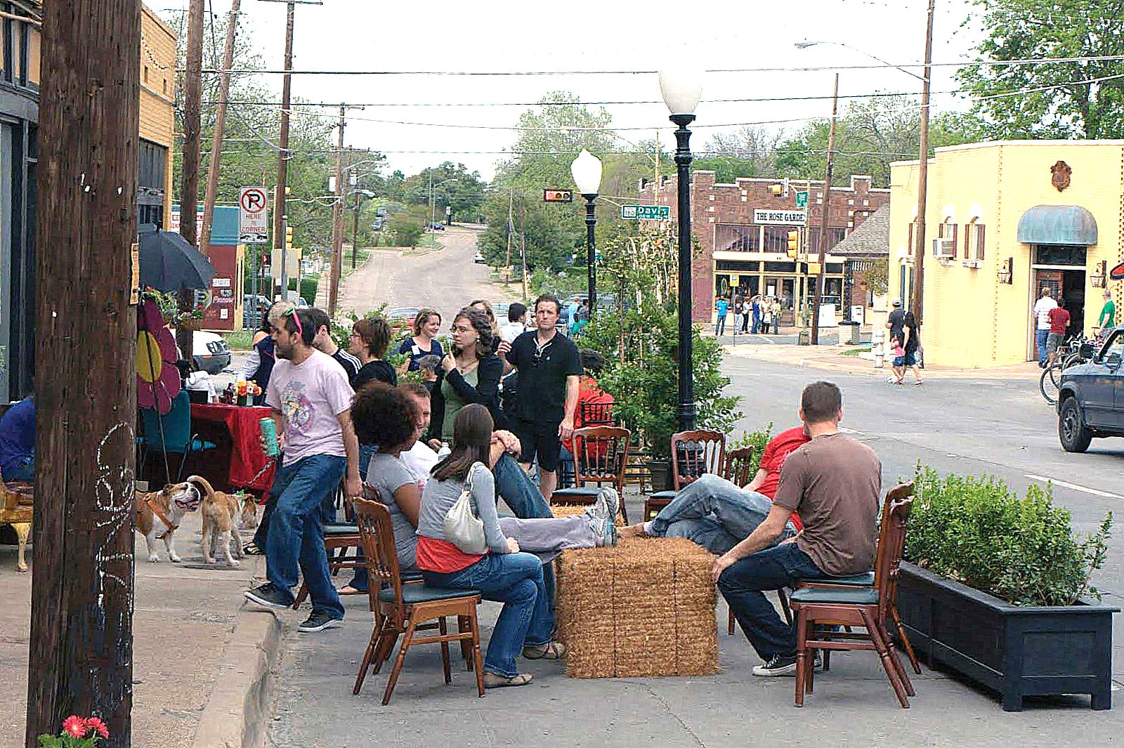
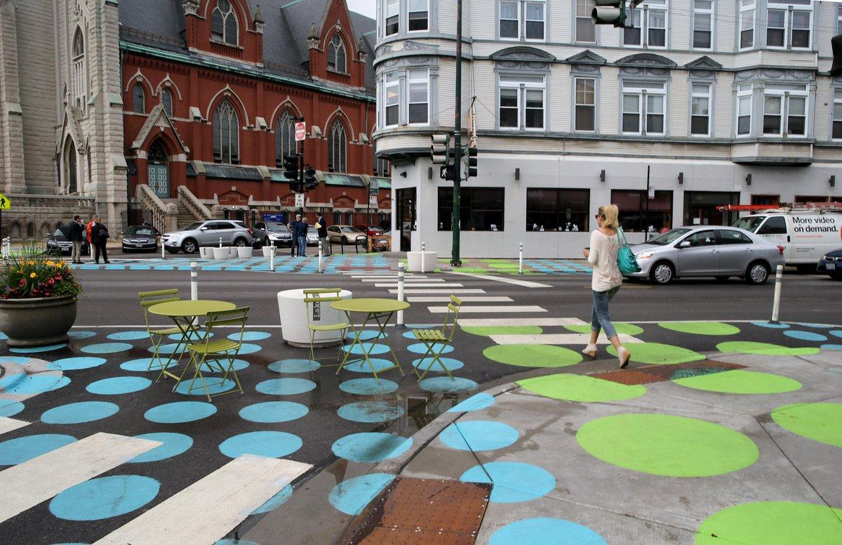
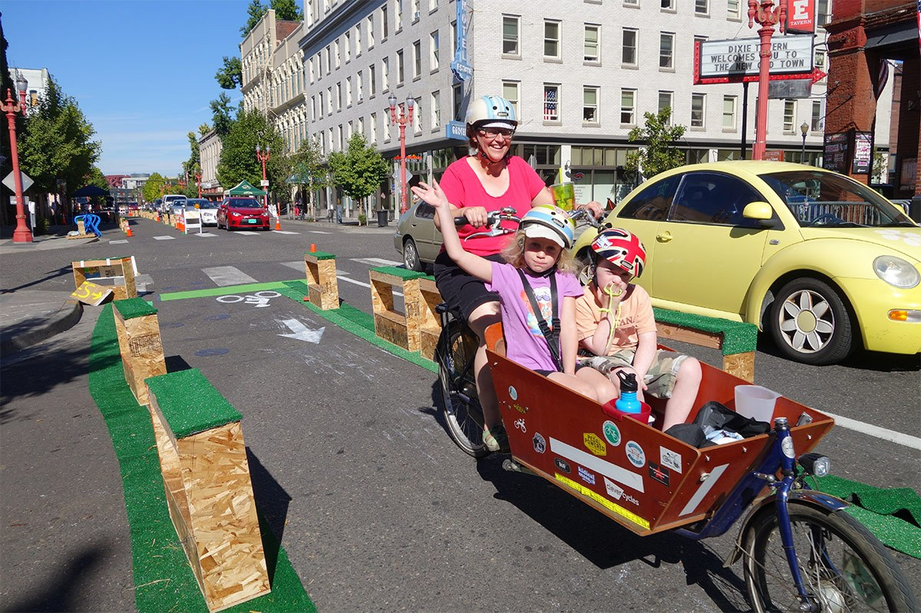
Tactical Urbanism
We can perform controlled experiments
Quick
Inexpensive
Reversible

