Slide 1

CAN-Do 2016
Hamilton
Content
A bit of Hamilton’s History
Hamilton growth
Partners – The wheeled pedestrian
A biker is not a wheeled pedestrian
Change
Notes:
My name is Peter Bos, I’m part of the CAW team.

Slide 2
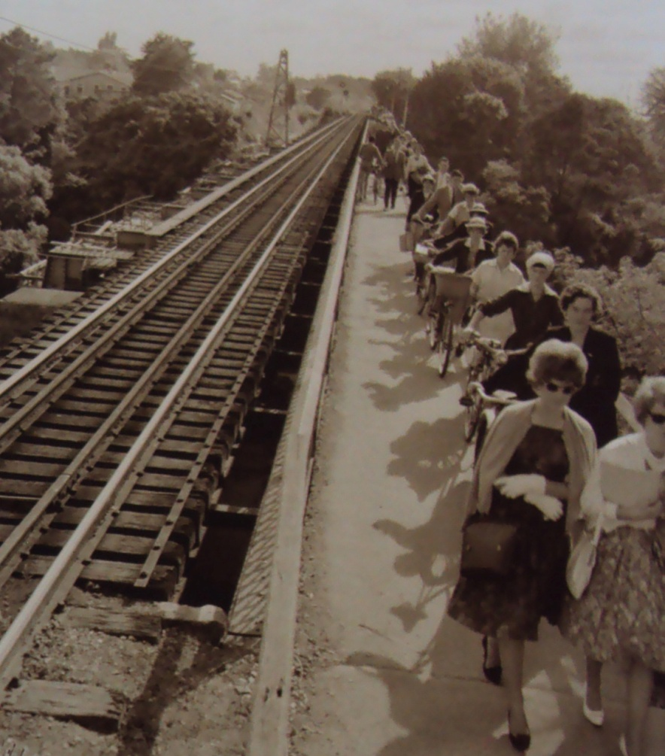
Claudelands rail bridge
Built in 1888 without footpath
Didn’t stop Pedestrians using it
1888 wooden planking was removed
People fined for crossing including town clerk
Footpath added 1908
Note it took 20 years
Notes:
Keeping left, cyclists dismount
When the railway bridge was built there was no footbridge included. However, that didn’t stop pedestrians from using it. In 1888 the wooden planking was removed to discourage pedestrians from crossing and some people were prosecuted, including Hamilton town clerk Mr J M Gelling, who was fined 5 shilling

Slide 3
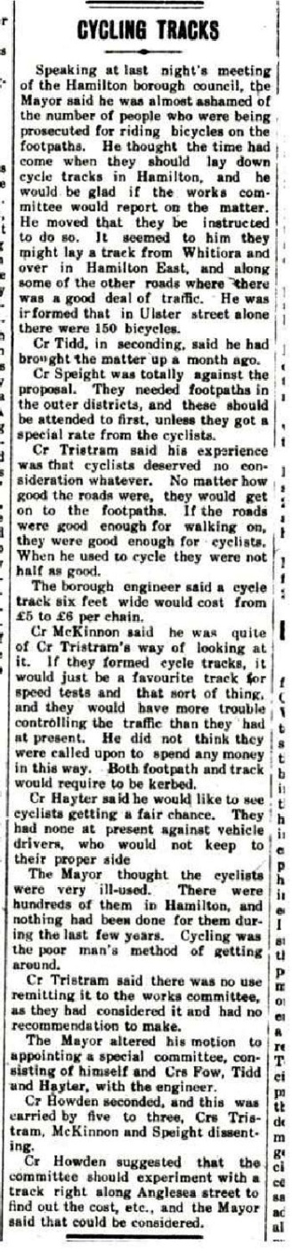
Hamilton Council meeting Sep 1913
Mayor said he was almost ashamed of the number of people who were being prosecuted for riding bicycles on the Footpaths. He thought the time had come when they should lay down cycle tracks in Hamilton ... He was informed that in Ulster St alone there were 150 bicycles.
Cr Speight was totally against the proposal ... Unless they got a special rate from the cyclist.
Cr Tristram said his experience was that cyclists deserved no consideration whatever (bla bla bla) When he used to cycle (bla bla bla)
Borough engineer said a cycle track six foot wide (1.8m) would cost from £5 to £6 per chain. ($784 to $940 per 20 meter)
Cr Mckinnon said ... If they formed a cycle tracks, it would just be a favourite track, for speed tests and that sort of thing, and they would have more trouble controlling the traffic than they had at present.
Cr Hayter said he would like to see cyclists getting a fair change. They had none at present against vehicles drivers, who would not keep to their proper side.
The Mayor ... Cycling was the poor man’s method of getting around.
Motion to appointing a special committee, carried by five to three
Cr Howden suggested that the committee should experiment with a track along Anglesea St.
The Mayor said that could be considered.
Notes:
Could change the names and date it 2016

Slide 4
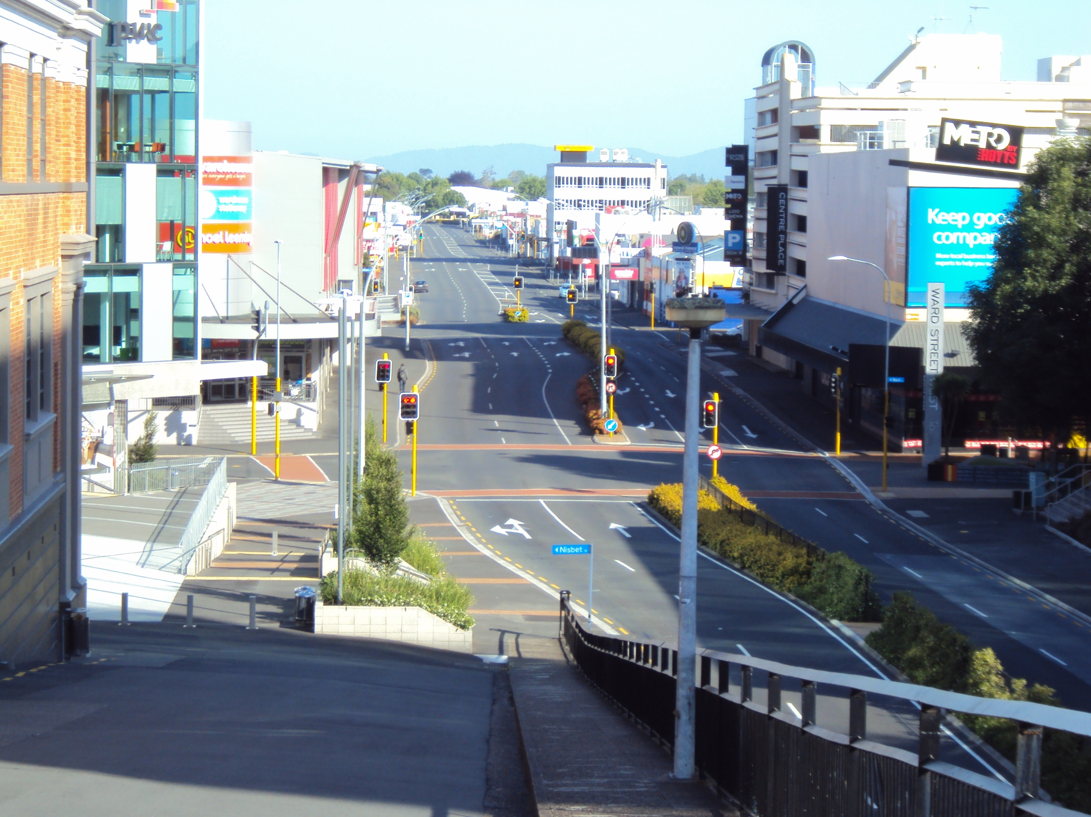
“Please note that while Anglesea St is quite wide in the southern part, it is narrow and quite unsuitable for cycling, in the northern part” – HCC 2013
Notes:
We ask for update on the project in 2013-

Slide 5
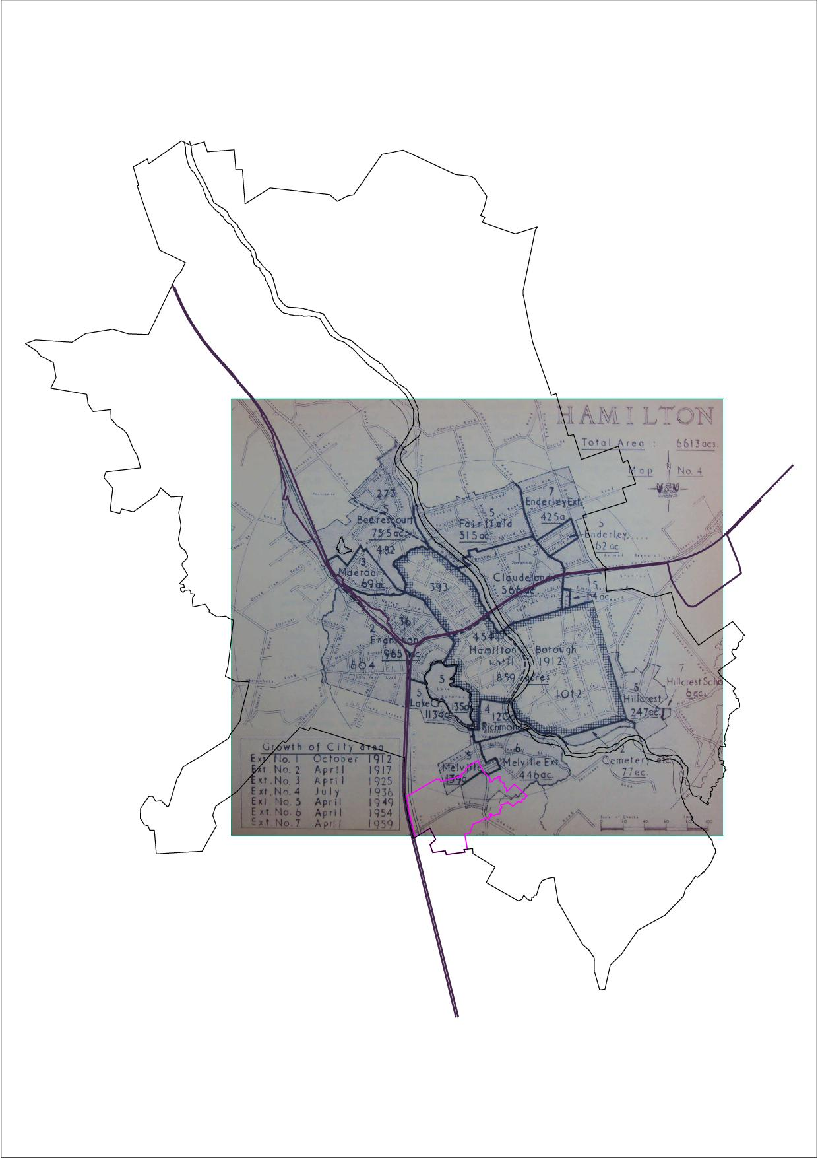
Hamilton’s Growth pop density p/km2
Year – Population – Density
1925 – 14,018 – 961
1936 – 16,150 – 1,063
1949 – 29,838 – 1,286
1954 – 35,917 – 1,436
1962 – 42,212 – 1,577
2013 – 150,200 – 1,533
Notes:
First local district plan was written in 1960s, looks to be a link between limiting higher density and town planning rules

Slide 6
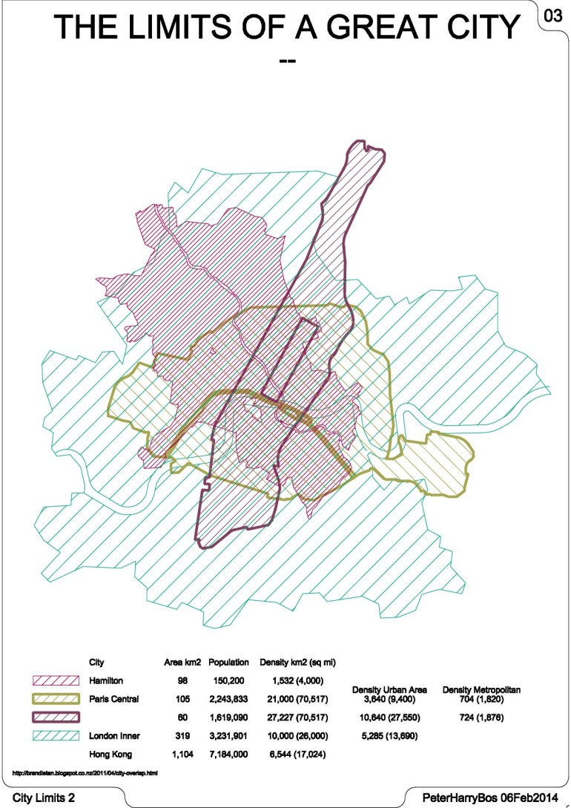
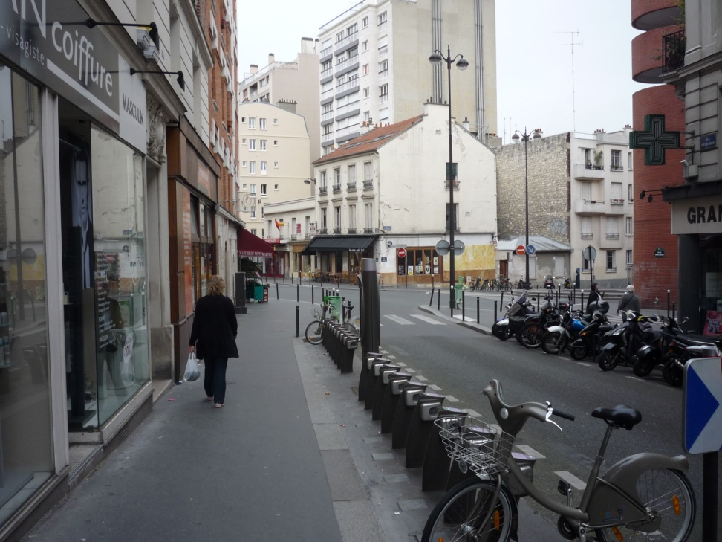
Hamilton is of a
Similar area to Central Paris
Larger than Manhattan
Smaller than Central London
Notes:
Paris 1 bike share per 97 inhabitants, London 1 per 984, NY 1 per 8,336 – would be interesting to see Hamilton with 1,500 bikes available, and no helmet laws.

Slide 7
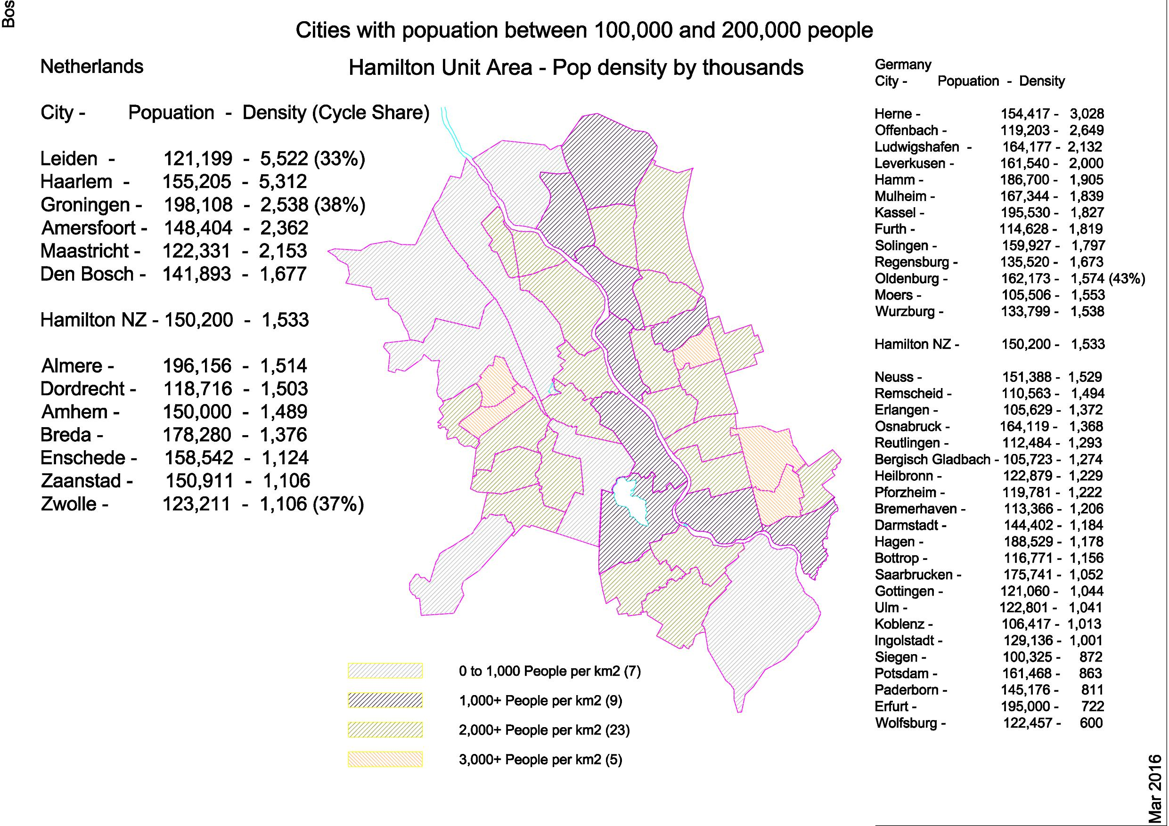
Notes:
It is common to hear people say “we don’t have the density of European cities”. If Hamilton NZ was a city in The Netherlands or Germany it’s compactness would be very average / normal.

Slide 8
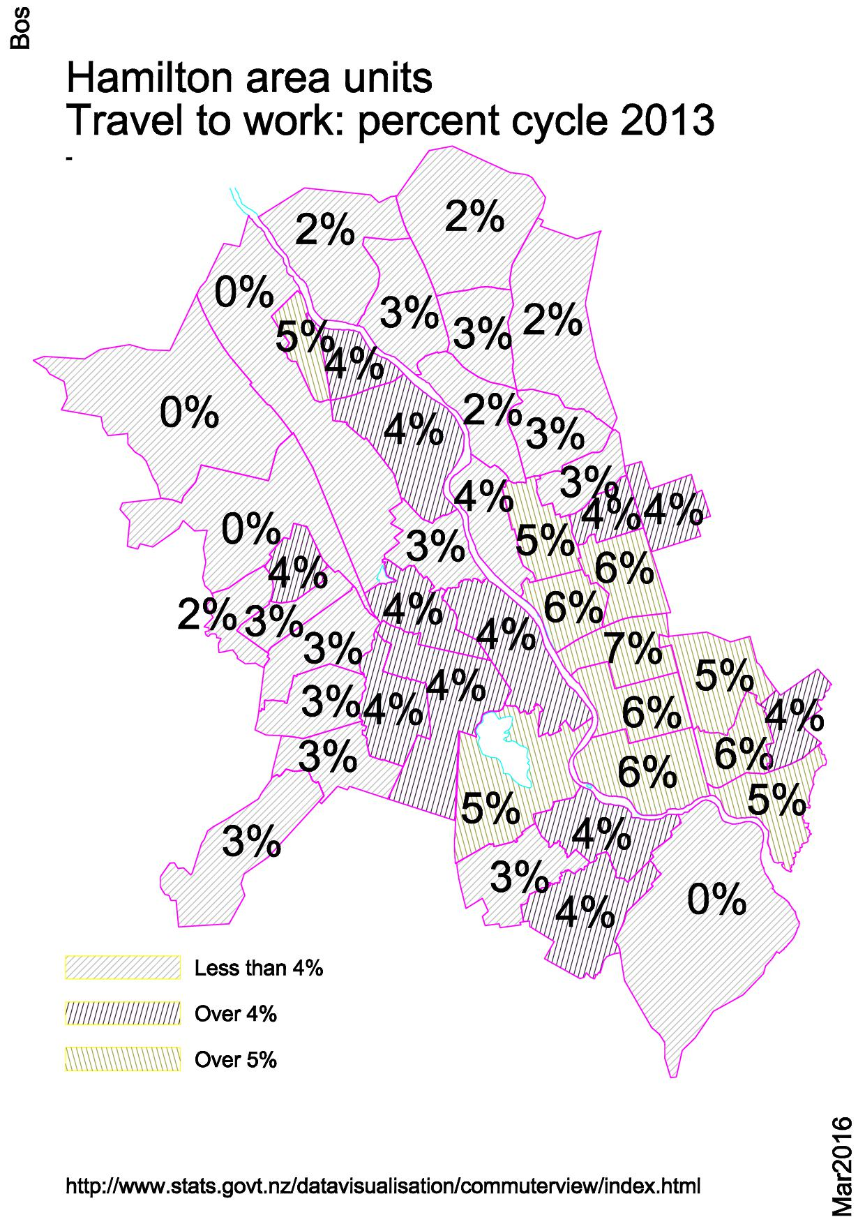
Cycling Safety Panel
“experience suggests that it takes time for any safety in numbers effect to be seen – it may not begin to have a noticeable effect until cycling reaches somewhere in the order of 5% of all journeys.”
Notes:
Rototuna Junior High School has about 630 students and about 60 per cent of them cycle, census data shows only 2% cycle to work in that area. New cycle paths in Melville area will bring it up to 5% in 2018 census.

Slide 9
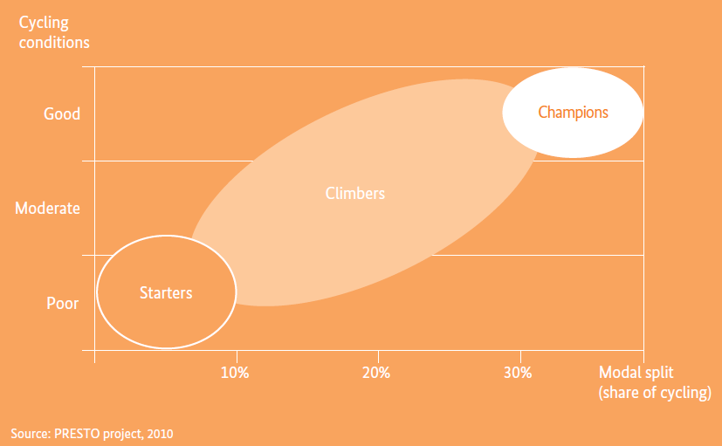
We want to be better than 5%
We what to be clearly above ten percent
Notes:
We want to be better than 5%, We what to be above 10%, have Good Cycling conditions and in some places be champions – from German 2020 cycle plan

Slide 10
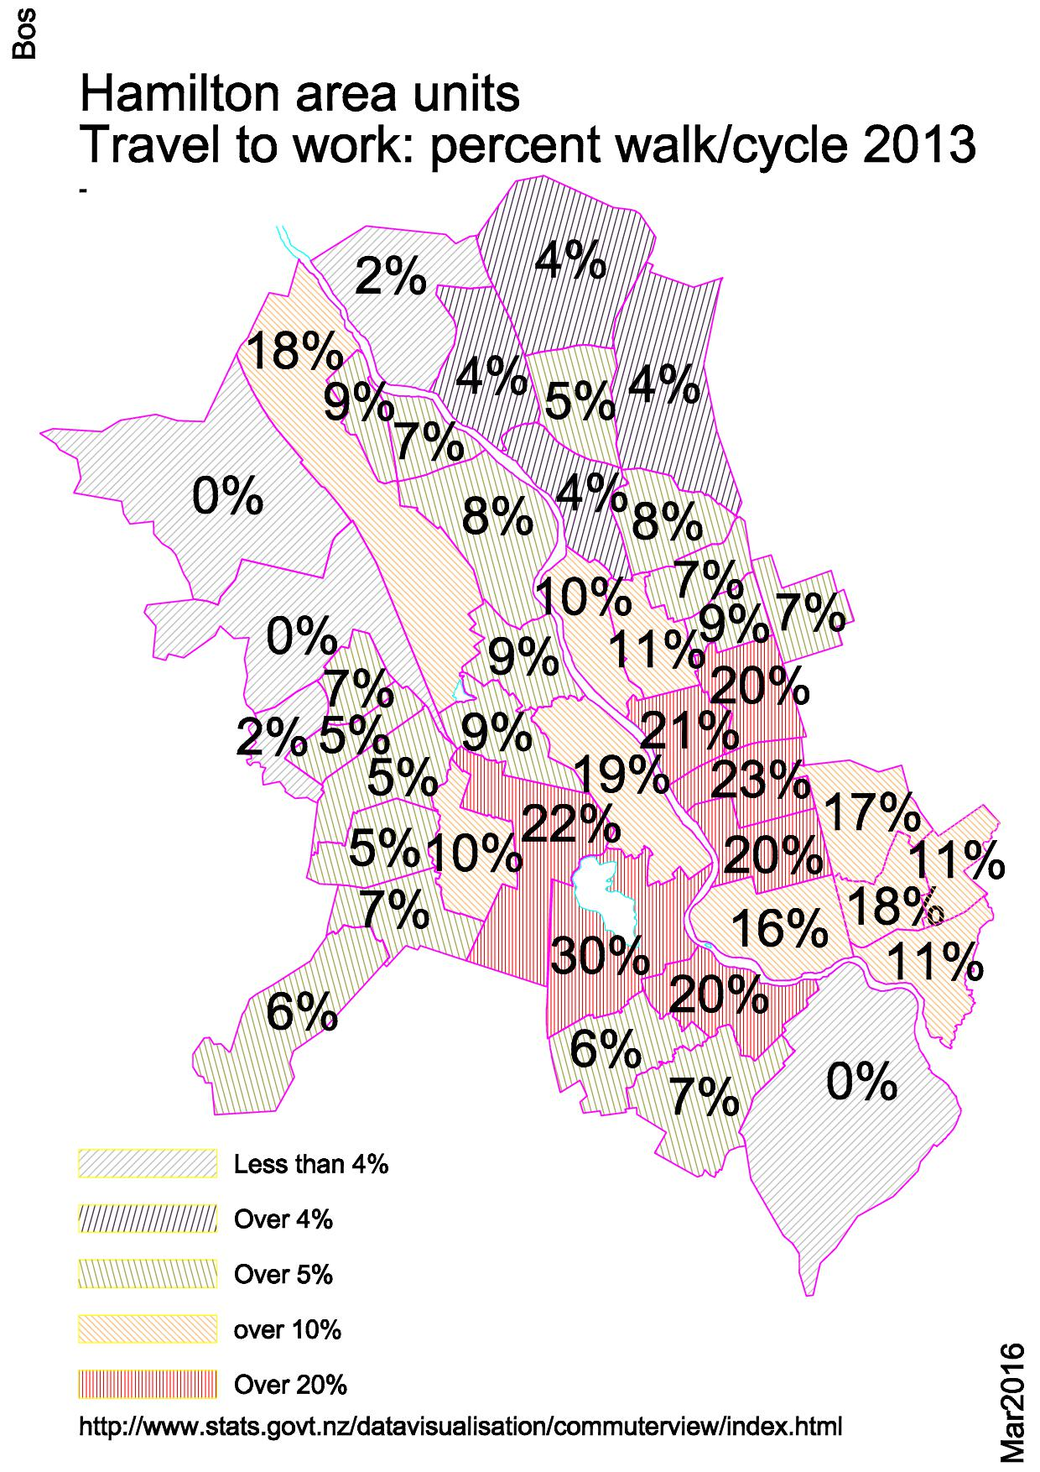
Cycle safety panel
“difference between the Dutch protests and other cycling advocacy campaigns is that “Stop de Kindermoord” was not about cycling versus cars, it was about child safety on roads ... Cycling infrastructure was the most effective policy response to that problem, along with child friendly street designs that reduced driving speeds and improved facilities for walking. “
Notes:
Its about people thinking it is safe and normal to walk or cycle – what we want is champion areas

Slide 11
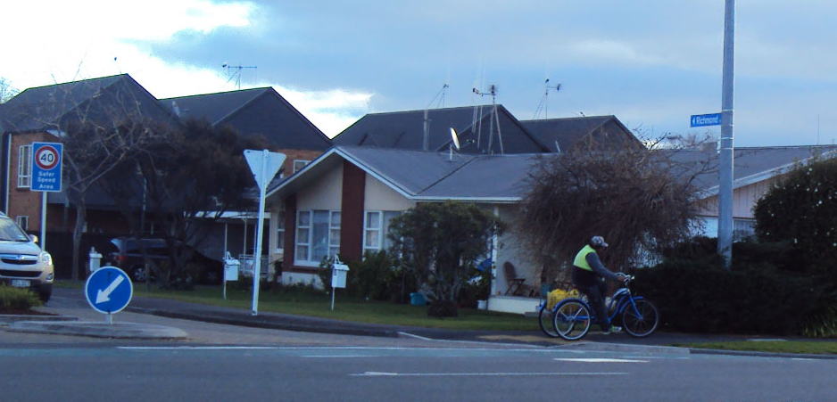
Six weekly meeting with HCC safety improvement team
Living Streets
CCS Disability Action
Blind Foundation
Cycle Action Waikato
Gen Zero
Visually impaired adviser – HCC
Sport Waikato
Notes:
We have General discussion on what is happening, share thoughts on highest priorities, share submissions.

Slide 12
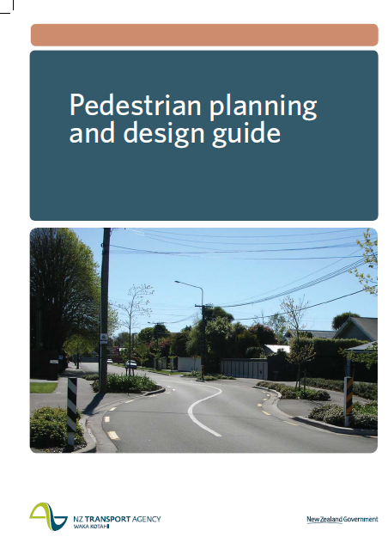
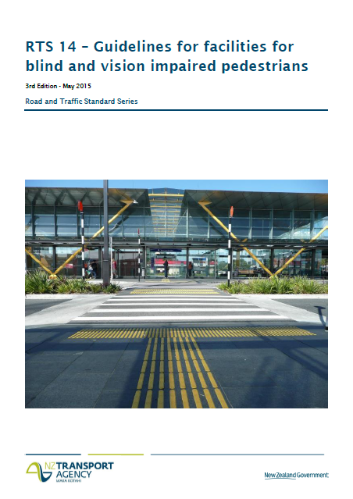
The wheeled Pedestrian
Driveways
When deciding whether to design a high volume entrance as an intersection consider:
Is the driveway busy enough? – at least above 500 vehicles per day?
Warning indicators .... should not normally be used, for driveway crossings, where they may imply (incorrectly) that vehicles have right of way.
It should be remembered that pedestrians have the right-of-way at driveways.
Notes:
It is important to protect right of way. we like to call any vehicle accessway with under 500 vpd a driveway crossing where pedestrians have right of way. See Guidelines for vision impaired.

Slide 13
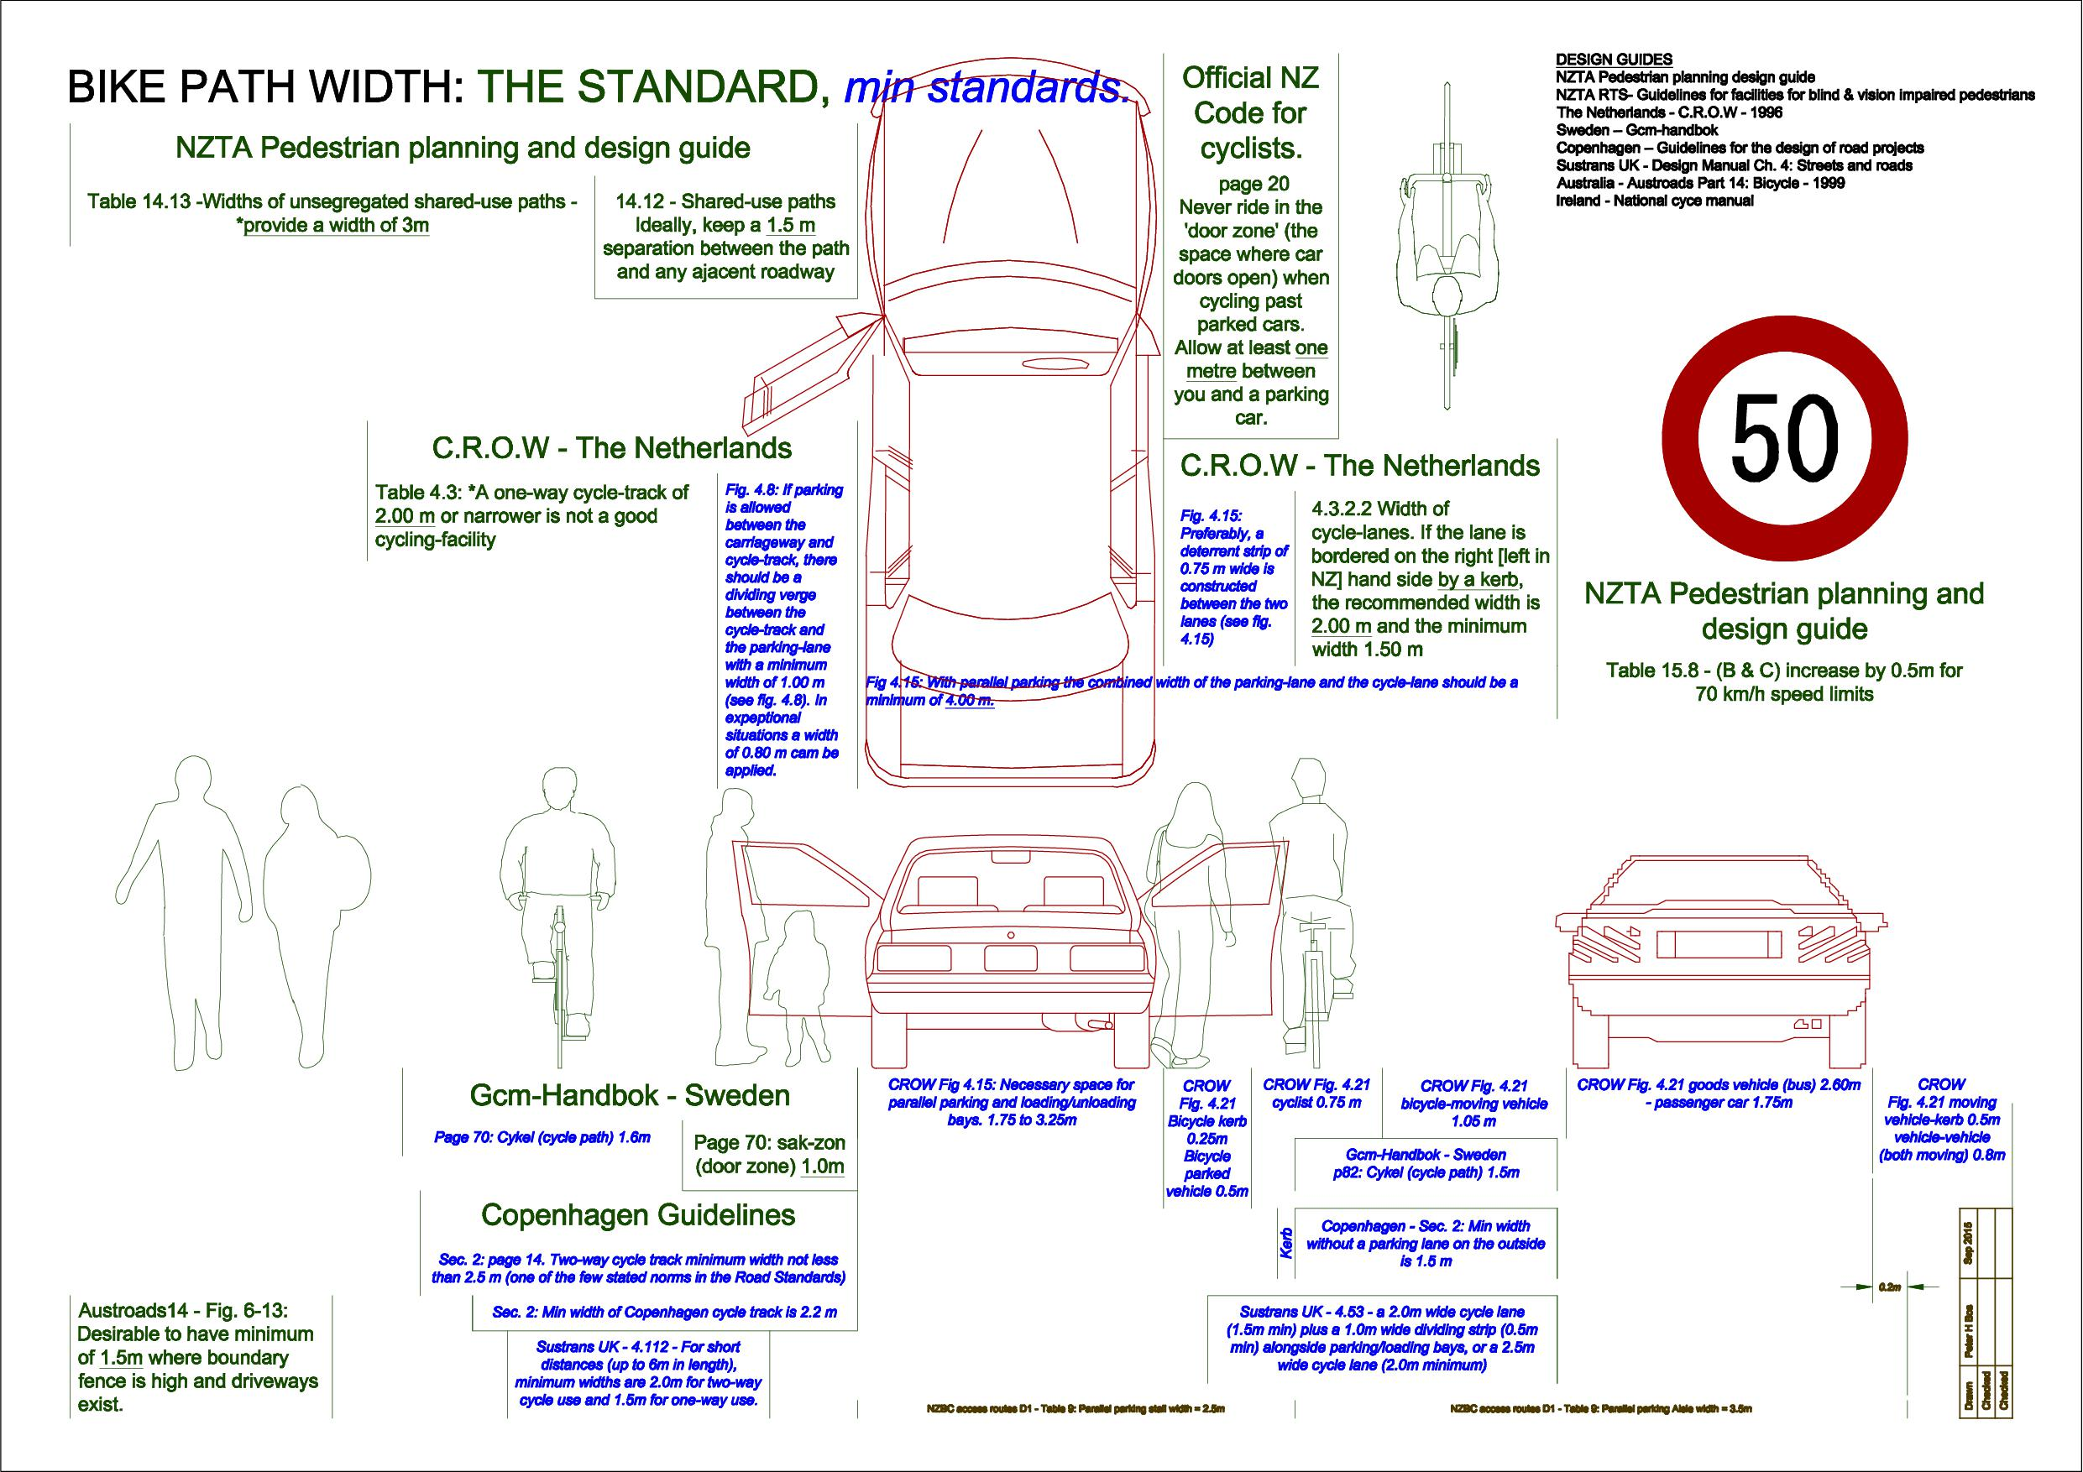
Notes:
The “Pedestrian design guide” along side with “code for cyclists” is equal to any designs guide. Keeping it simple.

Slide 14
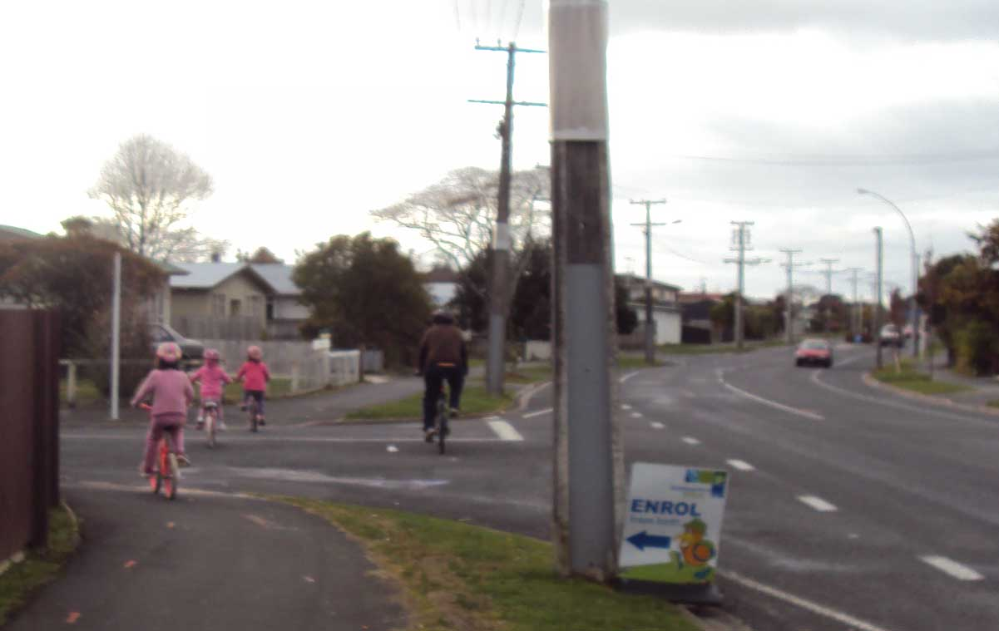
A person riding a bicycle is not a wheeled pedestrian
Notes:
These kids are going to grow to become a nuisance to older people sharing the foot paths.

Slide 15
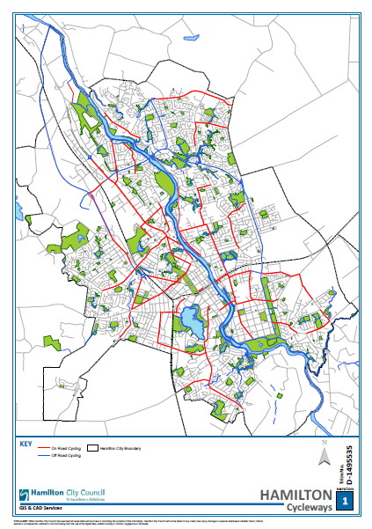
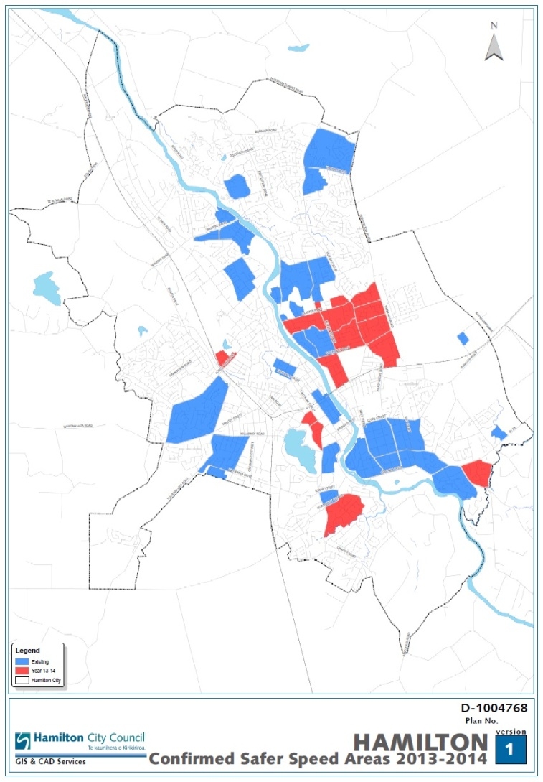
HCC Same goal changing approach
2005 -2015 2009 Ten year plan
2012 - 2014 Safer speed
Notes:
Approach hasn’t been lasting for more than a few years. Cycle plan loses funding (Change of government), Council changed approach but then lost political support. (thanks to Police enforcement, made it look like revenue gathering). But a lot of on road parking did get removed in 2005 cycle plan.

Slide 16
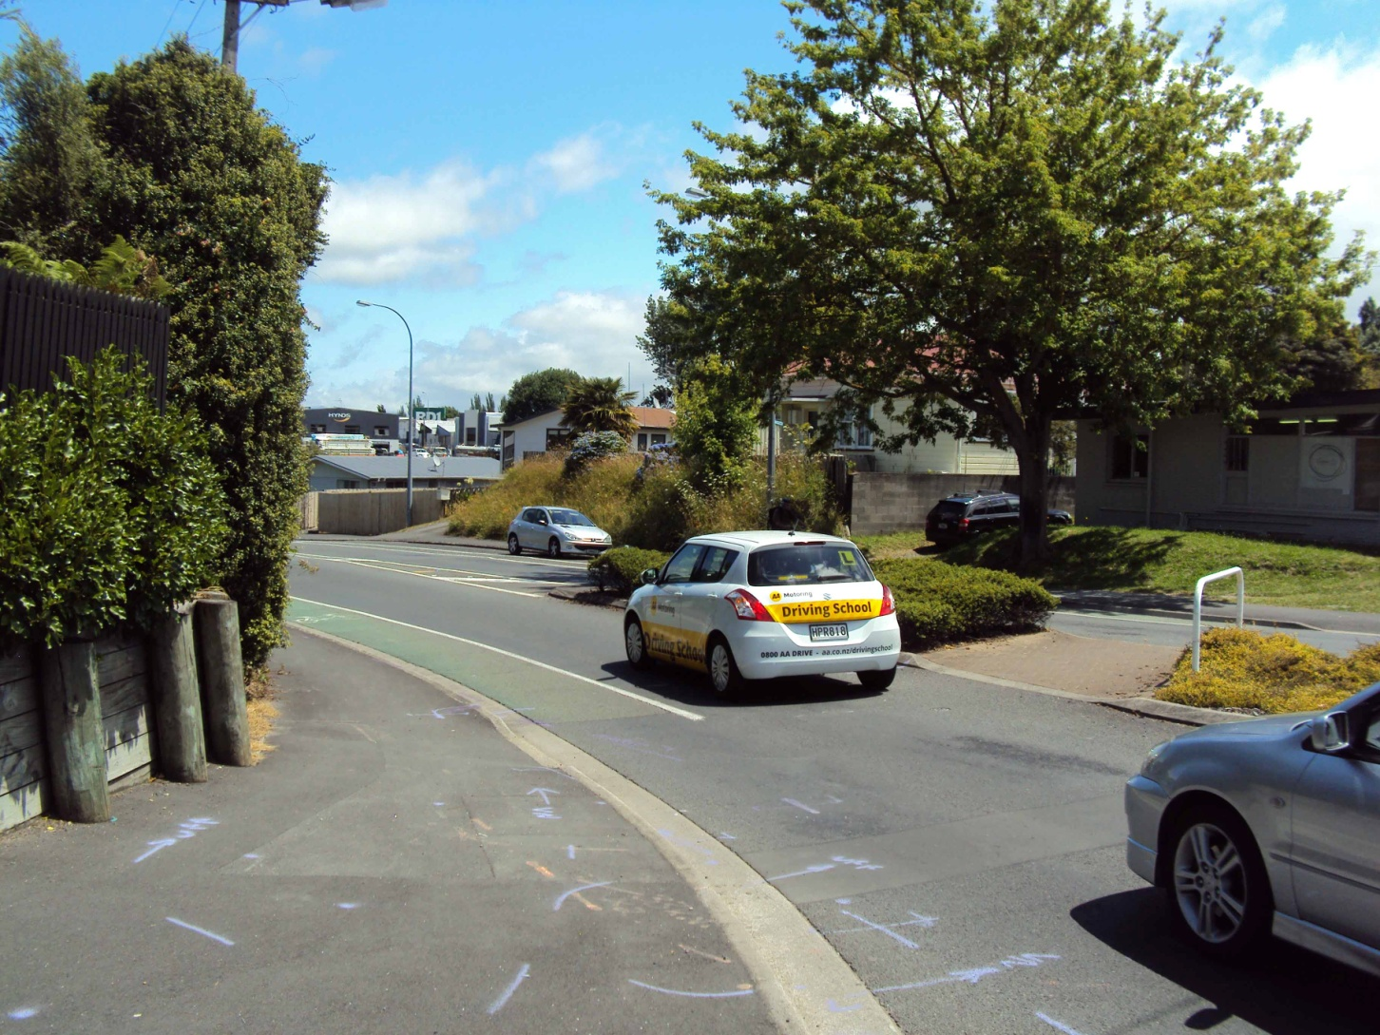
Notes:
Hamilton City Council cycle lane width 1.5m with Car lane to suit. It is little things that make a big difference

Slide 17
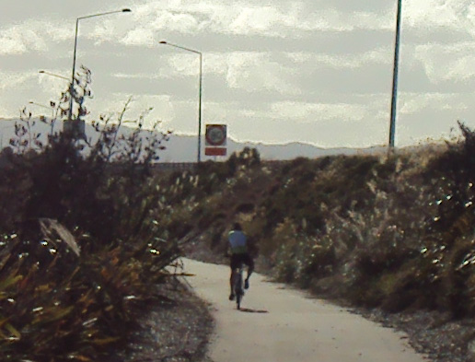
Notes:
Partner NZTA and Hamilton City Council we do get good outcomes – Te Rapa Bypass, a good wide off road path.

Slide 18
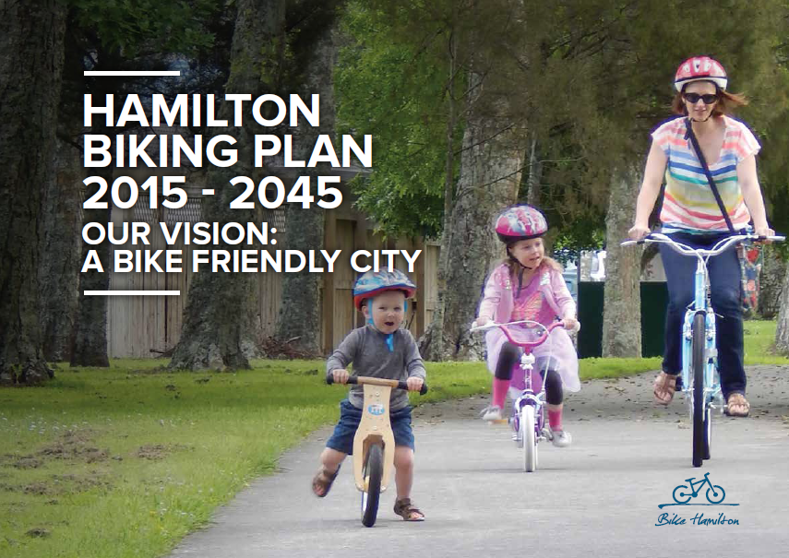
Hamilton’s 2015 approach
There are a number of approaches for providing biking Infrastructure ... separate people on bikes from vehicles ... particularly where the users are likely to be children.
Notes:
First we need it safe for novices, Adults need to talk less about danger and more about how safe it is.

Slide 19
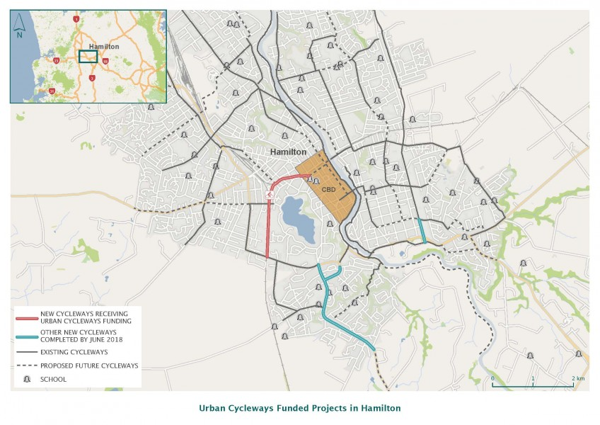
Transit NZ - NZTA
Always has cycle champions
Always lots of projects
Proactive
Supportive
Controls the funding
Easy to work with, just a lot to keep up with.
Notes:
To help we now have a NZTA person attend our cycle meeting once per month

Slide 20
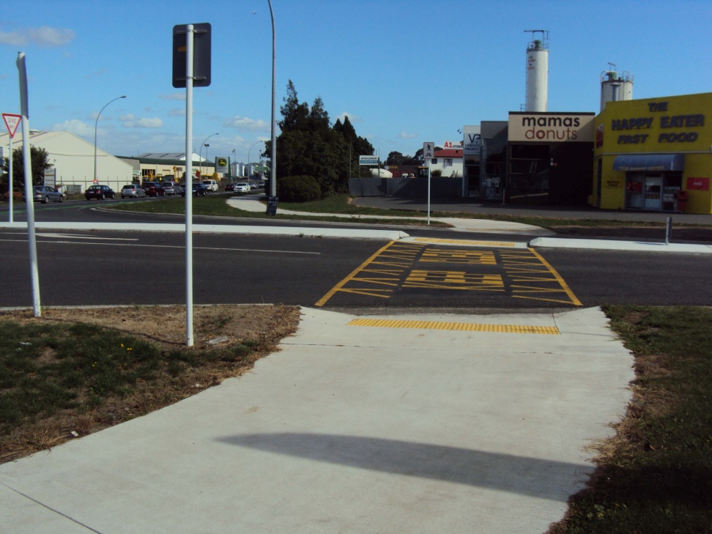
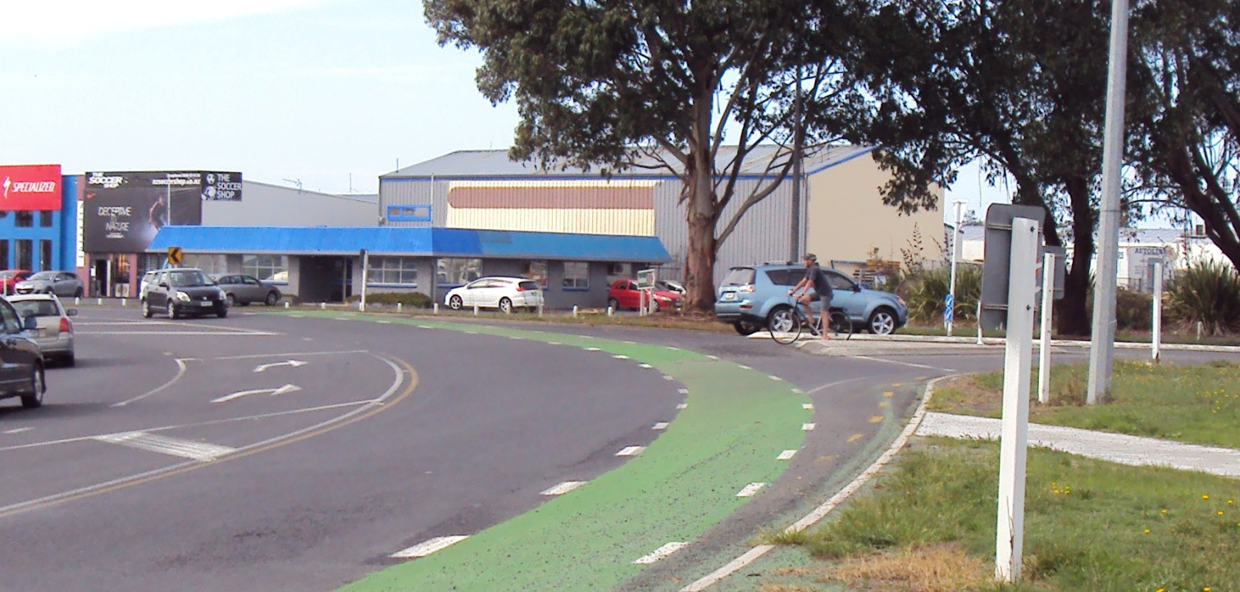
NZTA understands the different type and needs of cyclist.
Notes:
Yellow hatching does work, but no matter how good the off road paths are cyclist will still use the road. NZTA maintain on road cycle lane even when good quality off road cycle path are along side.

Slide 21
CAW change and new people changing approach
Listen to People outside our circle of activists.
Listen for talk about the different types of cyclist
Listen for talk about the benefits of cycling
Talk about cycle network having connectivity. It should be constructed with an destination.
State That funding should be set at $3.8 million per year
Outcome the writers/presenters of CAW submission, were all new to the council and council staff
Notes:
The group was burnt out, our chairman had nasty accident, our submission writers need a time out, council and government lots of endless consultation very little investment. (the 40km program did not need much input from CAW)

Slide 22
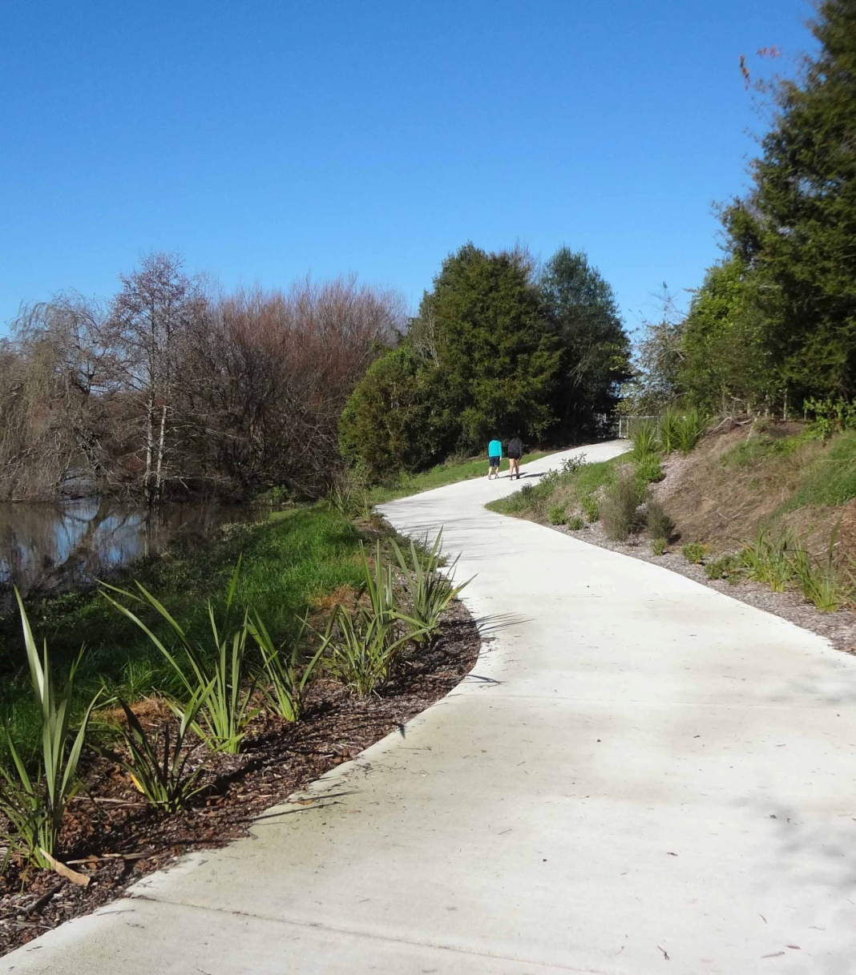
Successful branding, along side attractive infrastructure
Otago Central Rail Trail
Te Awa The Great New Zealand River Ride
Hauraki Rail Trail
Western Rail Trail
The Home of Cycling
Notes:
A few rail trails in that lot, People talking about riding

Slide 23
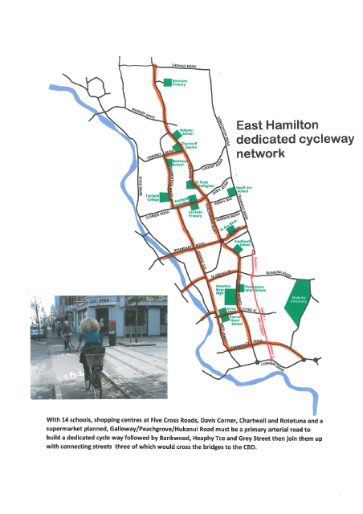
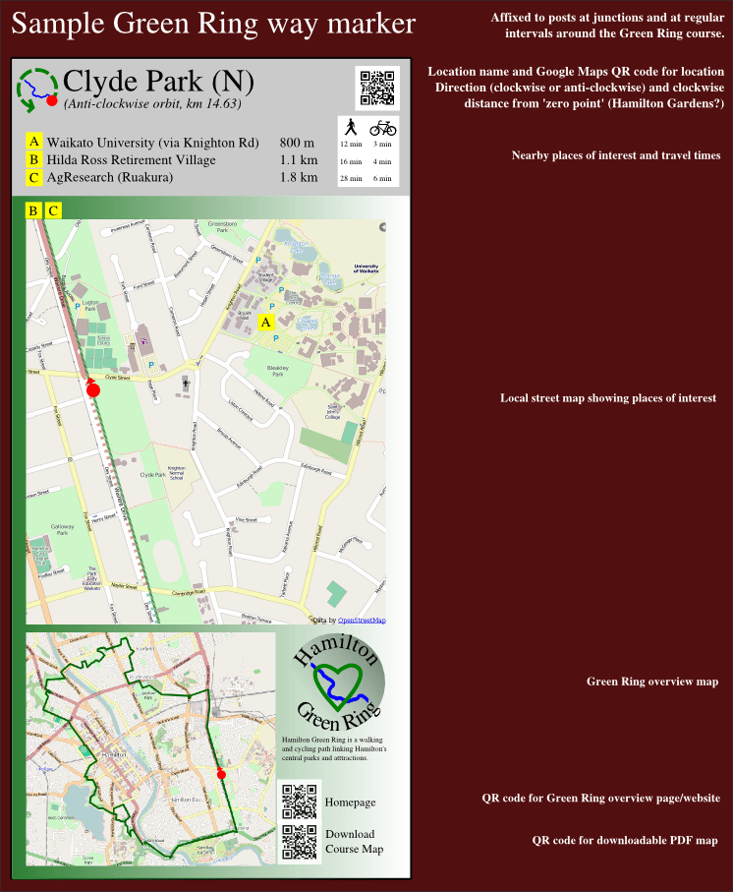
New people new projects

Slide 24


New people, New approach
Facebook – Bike Hamilton
Hamilton Urban Blog
Twitter
We still have post box No. , cheque book and Email for a few of us older people
Notes:
END

