Slide 1
Submission on
Hamilton 2018-2028
10-Year Plan
Ashley Hooper

Slide 2
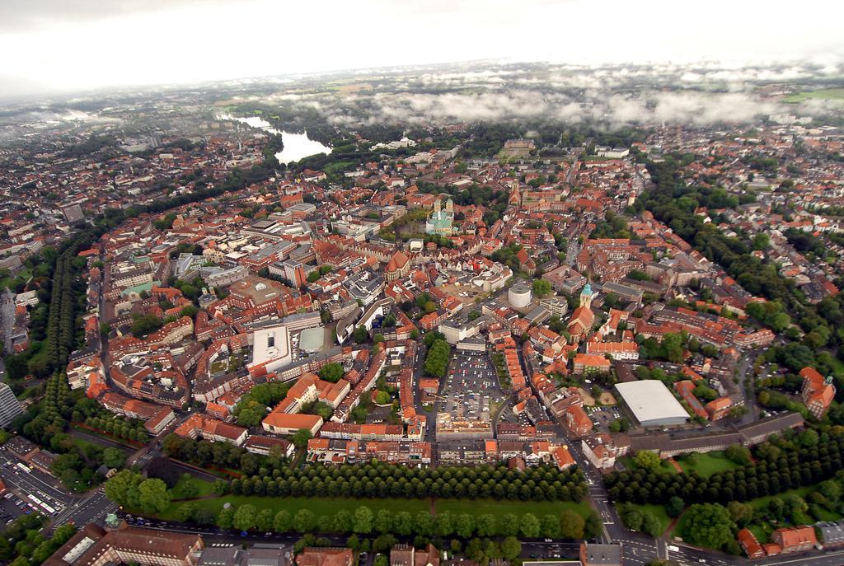
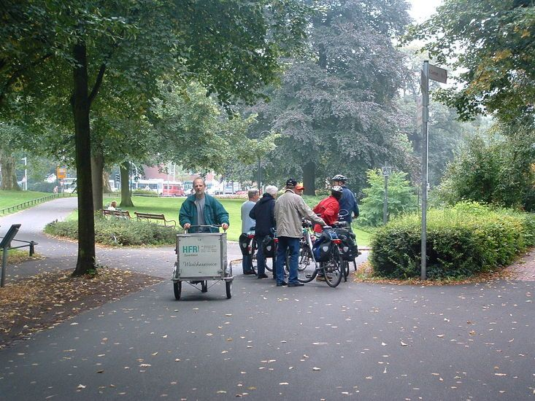
Inspired by Münster’s green belt

Slide 3
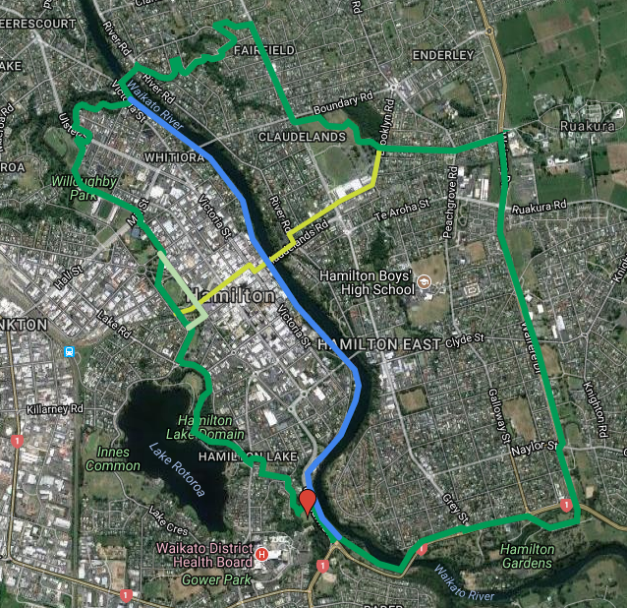
An 18.5 km loop linking remnants of historic Hamilton town belt, including many attractions and amenities:
Hamilton Gardens
Hamilton Lake Domain
Claudelands Park and Event Centre
Hamilton Transport Centre
Waikato Stadium
Seddon Park
Waikato Hospital
Ruakura Research Centre
Waikato River Paths
Founders Theatre

Slide 4
Most of the paths are already there and linked
Especially East of the river
Remainder could be built in stages

